Slide 1
TIM 58 Chapter 6, continued: Behavioral Modeling

Slide 2
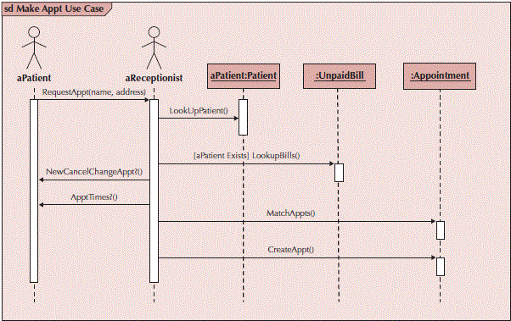
Sample Sequence Diagram

Slide 3
Building Sequence Diagrams
Set the context
Identify actors and objects that interact in the use-case scenario
Set the lifeline for each object
Add messages by drawing arrows
Shows how they are passed from one object to another
Include any parameters in parentheses
Obvious return values are excluded
Add execution occurrence to each object’s lifeline
Validate the sequence diagram
Ensures that it depicts all of the steps in the process

Slide 4
Communication Diagrams
Depict the dependencies among the objects
An object diagram that shows message passing relationships
Emphasize the flow through a set of objects

Slide 5
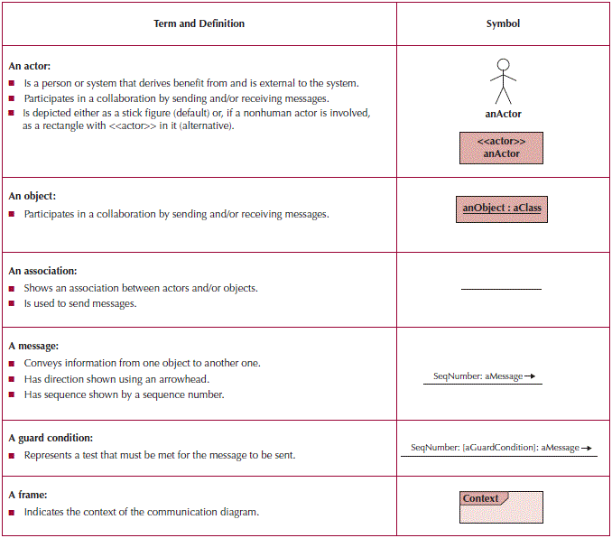
Communication Diagram Syntax

Slide 6
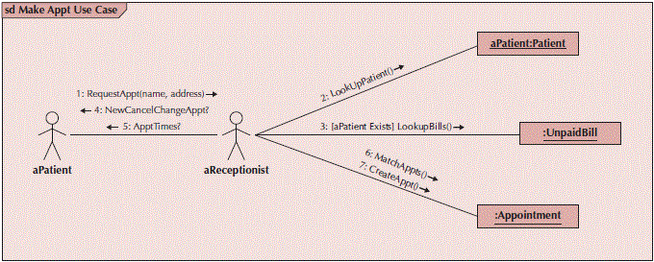
Sample Communication Diagram

Slide 7
Building Communication Diagrams
Set the context
Identify objects, actors and associations between them
Lay out the diagram
Add the messages
Validate the model

Slide 8
Behavioral State Machines
Objects may change state in response to an event
Different states are captured in this model
Shows the different states through which a single object passes during its life
May include the object’s responses and actions
Example: patient states
New patient—has not yet been seen
Current patient—is now receiving treatment
Former patient—no longer being seen or treated
Typically used only for complex objects

Slide 9
Components of State Machines
States—values of an object’s attributes at a point in time
Events—the cause of the change in values of the object’s attributes
Transitions—movement of an object from one state to another
May include a guard condition to flag that a condition is true and allow the transition

Slide 10
State Machine Syntax

Slide 11
Sample State Machine
Notes:
An event is something that takes place at a certain point in time and changes value(s) that describe an object. This in turn causes a change in the state of the object. Examples of events include a condition becoming true, a receipt of a call fro a method by an object, and the passage of a designated period of time. An action is an atomic, non-decomposable process that cannot be interrupted. Actions are often modeled as if they are completed in zero time, and they are associated with a transition. An activity is a non-atomic, decomposable process that can be interrupted. Activities take a long period of time to complete, they can be started or stopped by actions, and they are associated with states.

Slide 12
Guidelines for Creating Behavioral State Machines
Use only for complex objects
Draw the initial state in the upper left corner
Draw the final state in the bottom right corner
Use simple, but descriptive names for states
Look out for “black holes” and “miracles”
Ensure guard conditions are mutually exclusive
Ensure transitions are associated with messages and operations
Notes:
In the parlance of behavioral state machines, every event leads to a state transition. This is because events are defined as anything that changes a value which in turn describes the state of the behavioral state machine. In other words, transitions occur only as the result of an event. Specific types of events are as follows.
a) Data value change: a change in one of the data values that collectively describe the state of the object. For example, a patient transitions from “new” to “existing” after the first visit.
b) Boolean condition: a Boolean test that is applied at a certain point. For instance, after a patient transitions to “existing” we may ask the question “is the patient insured?” which would lead to state changes based on billing policies.
c) Time lapse: after a certain amount of time in a given state, the object may spontaneously change to a different state. For instance, a patient that is in state “inactive” (perhaps because he/she has no future appointments), may be removed from the system after 5 years.

Slide 13
Building a Behavioral State Machine
Set the context
Identify the states of the object
Initial
Final
Stable states during its lifetime
Lay out the diagram—use a left to right sequence
Add the transitions
Identify the triggers (events that cause the transition)
Identify the actions which execute
Identify the guard conditions
Validate the model—ensure all states are reachable

Slide 14
CRUDE Analysis
Helps to identify object collaborations
Labels object interaction in 5 possible ways:
Create—can one object create another?
Read—can one object read the attributes of another?
Update—can one object change values in another?
Delete—can one object delete another object?
Execute—can one object execute the operations of another?
Utilizes a matrix to represent objects and their interactions
Most useful as a system-wide representation

Slide 15
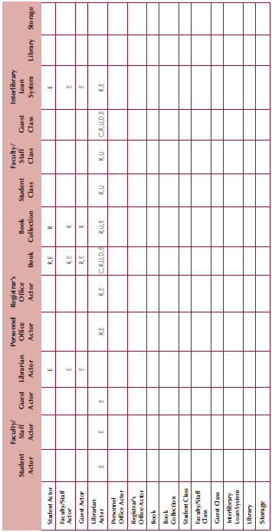
Sample CRUDE Matrix

Slide 16
Verifying & Validating Behavioral Models
Actors must be consistent between models
Messages on sequence diagrams must match associations on communication diagrams
Every message on a sequence diagram must appear on an association in a communication diagram
Guard conditions on a sequence diagram must appear on a communication diagram
Sequence of messages must correspond to the top down ordering of messages being sent
State transitions must be associated with a message on a sequence diagram
Entries in a CRUDE matrix imply messages being sent
Notes:
all transitions contained in a behavior state machine must be associated with a message being sent on a sequence and communication diagram, and it must be classified as a (C)reate, (U)pdate, or (D)elete message in a CRUDE matrix

Slide 17
Summary
Behavioral Models—provide a detailed view of how object collaborations support use-cases
Interaction Diagrams
Sequence diagrams
Communication diagrams
Behavioral State Machines—depicts the states of complex objects during its lifetime
CRUDE Analysis—helps to identify potential collaborations
Verifying & Validating behavioral models—ensures the completeness and consistency of the models

